Slide 1


HACKSPECTRUM
Project Name: GlycoTrack
Team Name : AIVitals
Team Members
Shinjan Bhatta Mekhla Sen
Joydeep Sarkar Rankit Saha
Atreyee Das
Affiliations: Institute of Engineering and Management, Kolkata
Date: 22nd March, 2025

Slide 2
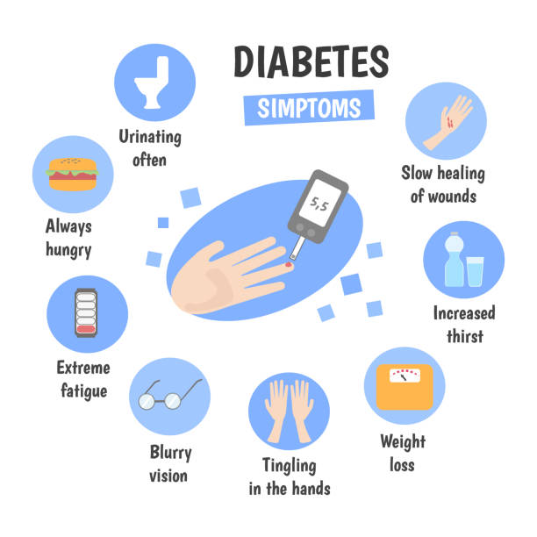
Introduction
Diabetes is a growing health crisis, particularly in rural and underserved areas with limited access to healthcare facilities.
Our project is an AI-powered system that predicts diabetes risk based on patient data such as age, gender, and symptoms
This innovative solution leverages machine learning, Gemini API for medical recommendations, providing a fast, accessible, and cost-effective diagnostic tool.

Slide 3
Problem Statement
GlycoTrack is designed to address the limitations of traditional diabetes diagnosis methods, which require laboratory tests and doctor consultations.
These conventional processes are often expensive, time-consuming, and inaccessible to people in remote areas.
By introducing an AI-driven, web-based diagnosis system, we provide a solution that is: Affordable, Accessible, Efficient, Scalable

Slide 4
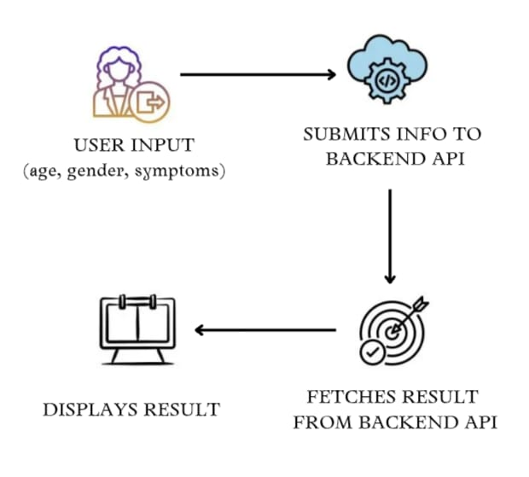
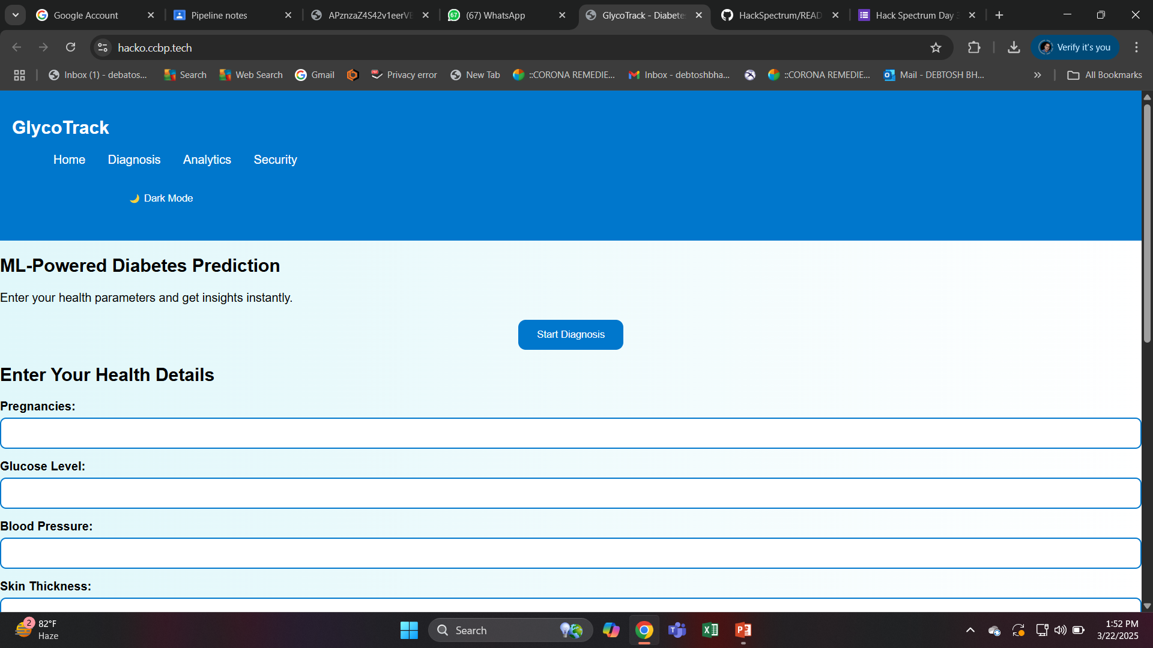
Methodology
GlycoTrack is structured into frontend and backend components, ensuring a seamless user experience and accurate diagnosis.
Frontend Development:
Developed a user-friendly web interface using HTML, CSS, and JavaScript.
Integrated a dark mode toggle for accessibility.
Included a diagnosis form where users enter their age, symptoms and necessary parameters
Displayed dynamic diagnosis results with medical recommendations.
Link to the interface: Click here

Slide 5
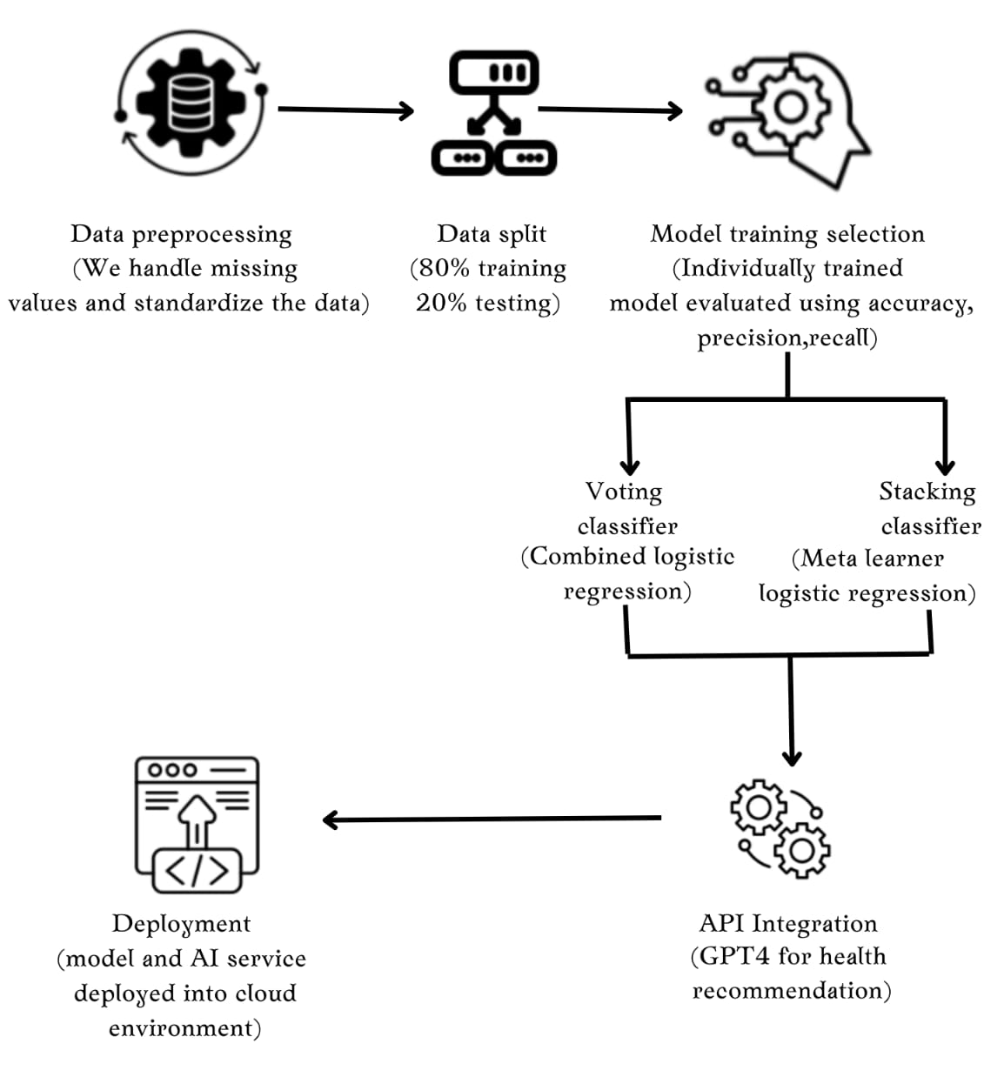
Methodology
Backend Development:
Trained a machine learning model using the Pima Indian Diabetes Dataset (PIDD) with 768 samples and 8 health indicators.
Evaluated multiple ML algorithms such as Logistic Regression, Random Forest, SVM, Naive Bayes, Gradient Boosting and KNN
Final Model: An ensemble model using Voting Classifier with accuracy 79.3%
Hosted the entire system on cloud infrastructure for scalability and efficiency.
The model is in compliance with HIPAA for data privacy

Slide 6
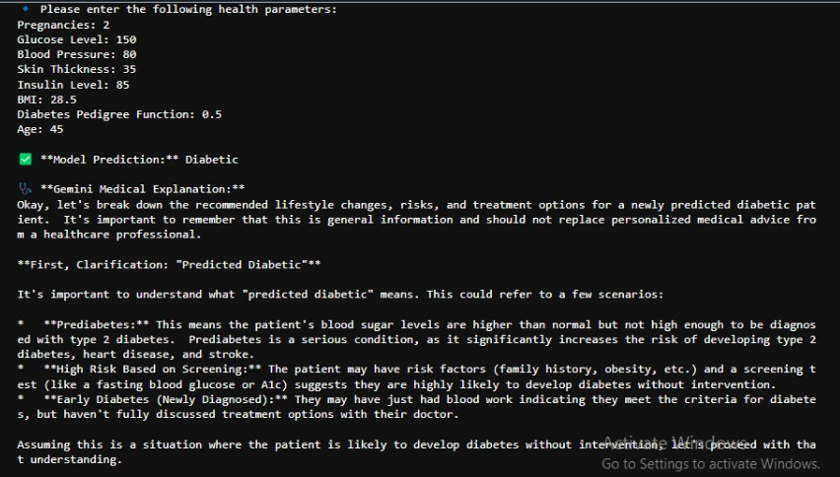
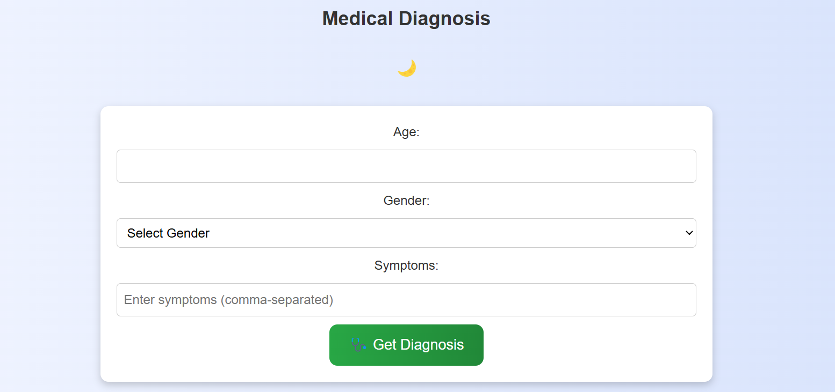
Methodology
API Integration:
The Frontend and Backend Interact with each other through API fetch.
Gemini API has been integrated in the backend model that provides preventive measures if a patient is non-diabetic and corrective steps if they are diabetic
Model Deployment: The model is deployed as a FastAPI web service with ngrok for public access.
Link to Github repository: Github
Link to Video demonstration: Video

Slide 7
Innovation and Benefits
GlycoTrack stands out due to its unique integration of AI, usability, and accessibility. Key innovations include:
AI-Based Remote Diagnosis: Eliminating the need for physical blood tests by using machine learning to predict diabetes risk.
Bridging the Healthcare Gap: Providing healthcare access to underserved regions via a web-based system.
Real-Time AI Insights: Using Gemini API for personalized health suggestions
User-Friendly Interface: Implementing features such as dark mode, intuitive UI, and seamless navigation.
Scalability and Cost-Effectiveness: Offering a highly scalable, cloud-based solution at a fraction of traditional diagnosis costs.

Slide 8





Team
Shinjan Bhatta
Rankit Saha
Atreyee Das
Joydeep Sarkar
Mekhla Sen

Slide 9
Thank You !!!

